Slide 1
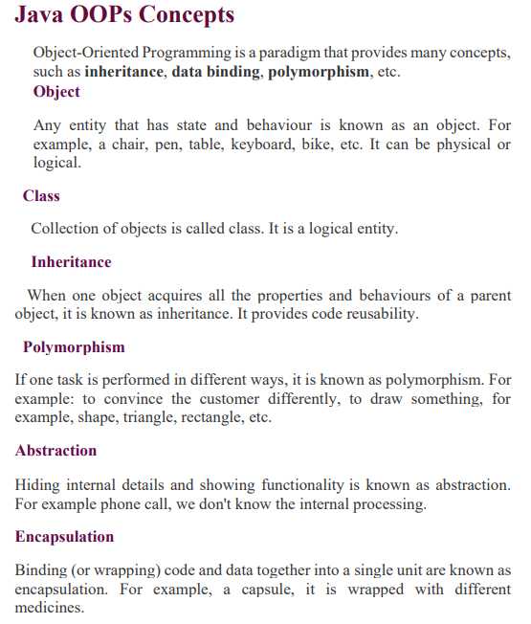

Slide 2
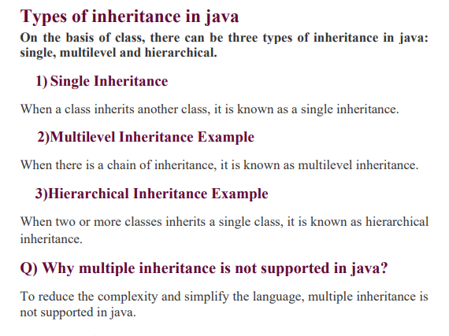

Slide 3
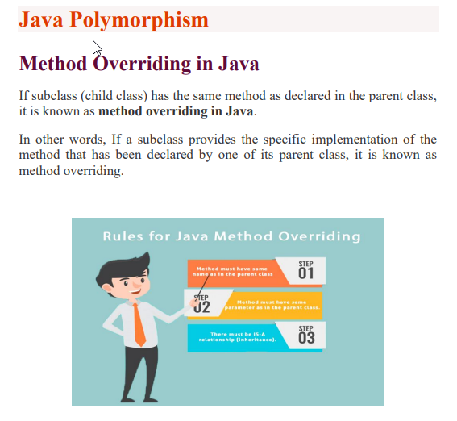

Slide 4
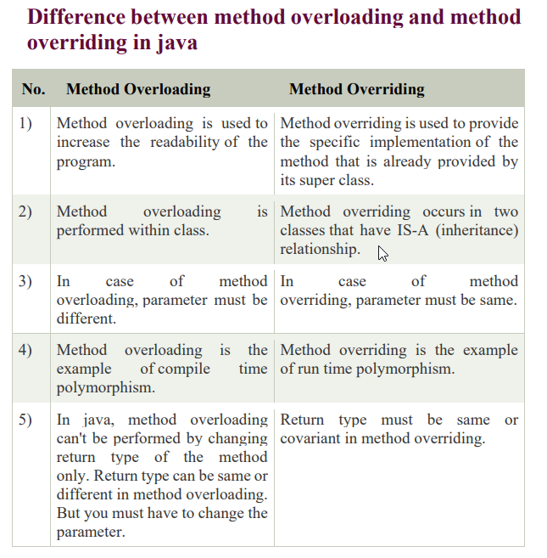

Slide 5
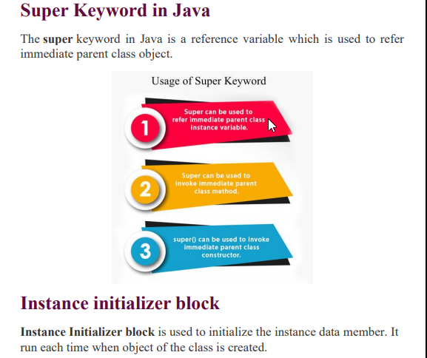

Slide 6
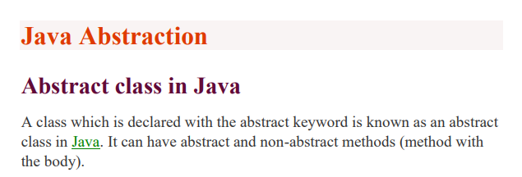
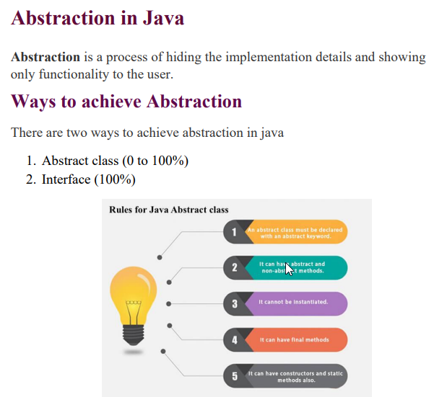

Slide 7
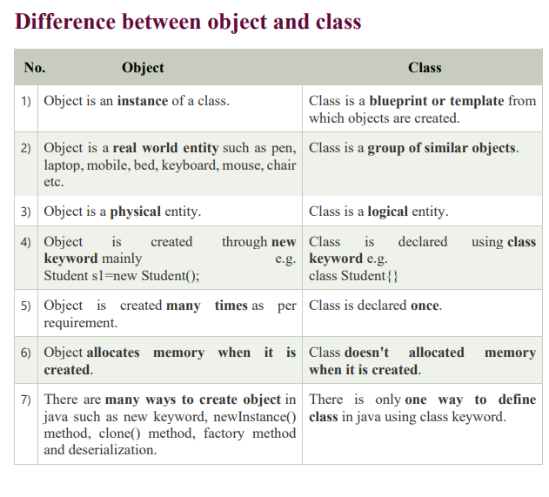

Slide 8
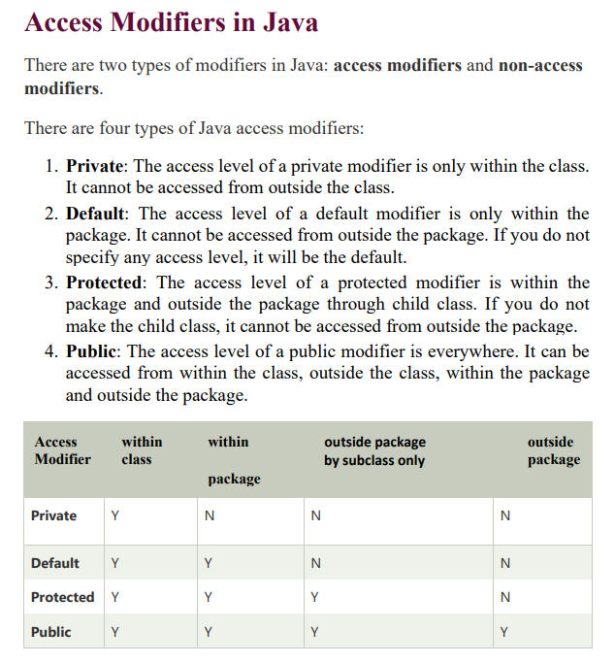

Slide 9
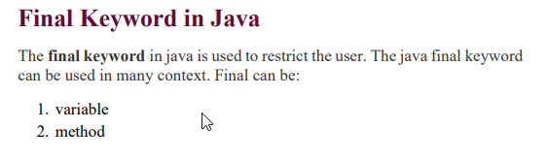
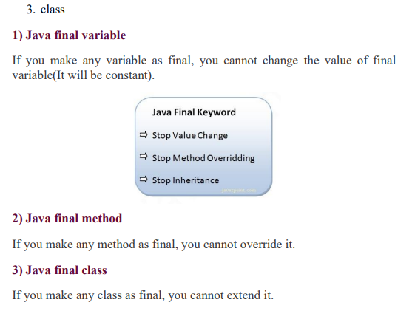

Slide 10
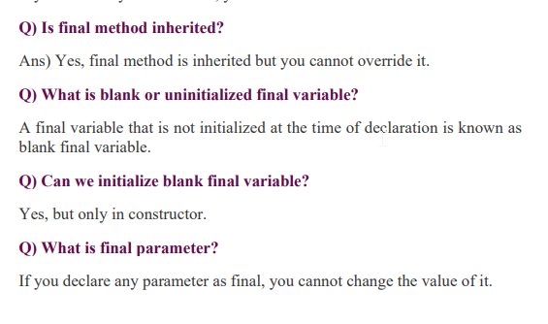


Slide 11
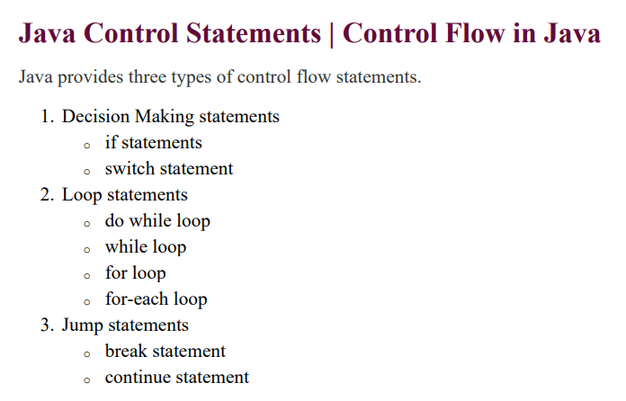

Slide 12
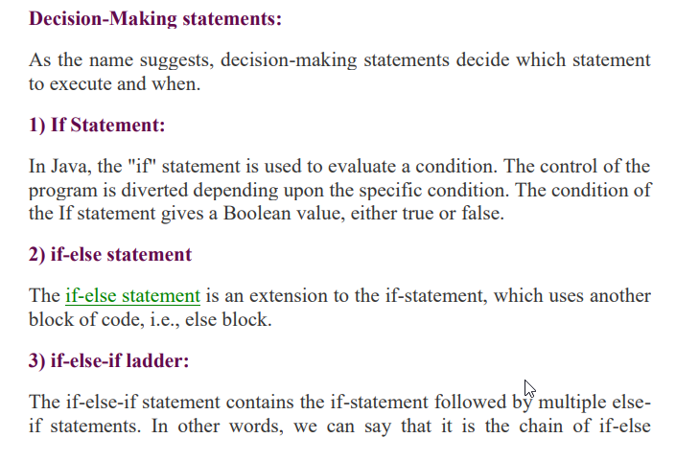
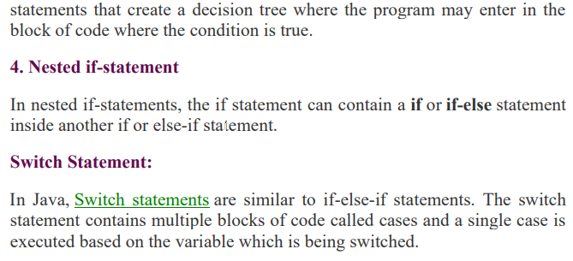

Slide 13
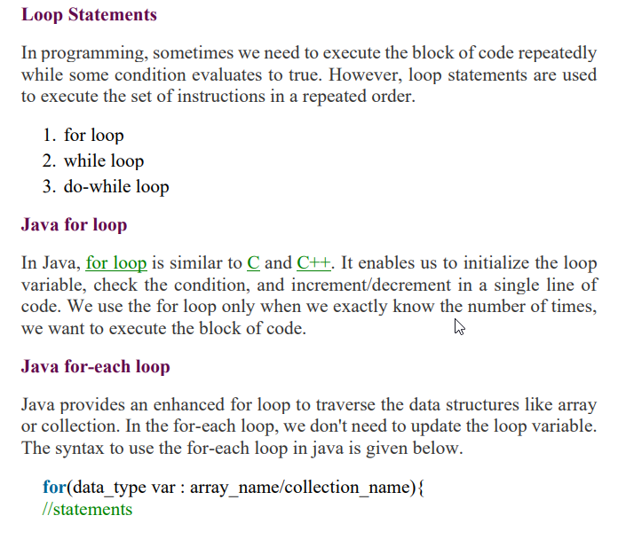

Slide 14

ForLoopExample
public class ForLoopExample {
public static void main(String[] args) {
for (int i = 1; i <= 5; i++) {
System.out.println(i);
}
}
}
for (int i = 1; i <= 5; i++): This is the for loop statement.
int i = 1: Initializes a variable i with the value 1. This is executed only once, before the loop starts.
i <= 5: This is the condition. The loop continues as long as i is less than or equal to 5.
i++: Increments the value of i by 1 after each iteration.
System.out.println(i);: This line prints the current value of i to the console.

Slide 15
DoWhile Example
public class DoWhileExample {
public static void main(String[] args) {
int i = 1;
do {
System.out.println(i);
i++;
} while (i <= 5);
}
}
Explanation:
The i variable is initialized to 1.
The do block starts, and the value of i is printed.
The value of i is incremented by 1.
The condition i <= 5 is checked. Since i is currently 2, the condition is true, and the loop repeats.
This process continues until i becomes 6.
When i is 6, the condition i <= 5 becomes false, and the loop ends.

Slide 16
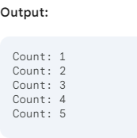
While Loop Example
public class WhileLoopExample {
public static void main(String[] args) {
int count = 1;
while (count <= 5) {
System.out.println("Count: " + count);
count++;
}
}
}
Explanation:
Initialization: An integer variable count is declared and initialized to 1.
Condition Check: The while loop checks if the value of count is less than or equal to 5. If true, the loop body executes.
Loop Body: The current value of count is printed to the console.
Increment: The value of count is increased by 1.
Iteration: The loop repeats from step 2 until the condition becomes false (i.e., count is greater than 5).

Slide 17
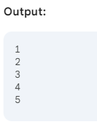
For Each Loop Example
public class ForEachLoopExample {
public static void main(String[] args) {
// Create an array of integers
int[] numbers = {1, 2, 3, 4, 5};
// Iterate over the array using for-each loop
for (int number : numbers) {
System.out.println(number);
}
}
}
Explanation:
Array creation: An integer array named numbers is created with values 1, 2, 3, 4, and 5.
For-each loop:
for (int number : numbers): This line declares a loop variable number of type int. The colon (:) indicates that number will take on the value of each element in the numbers array.
System.out.println(number): This line prints the current value of number to the console.

Slide 18
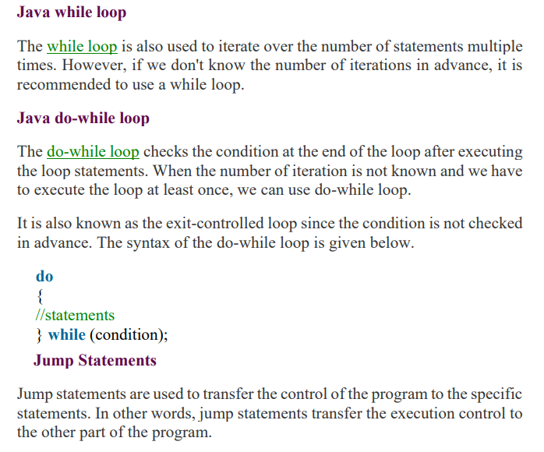

Slide 19
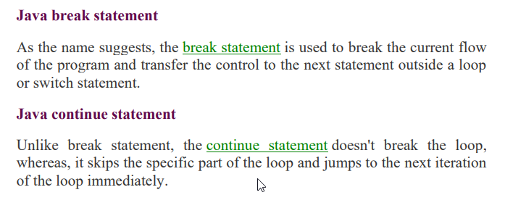

Slide 20
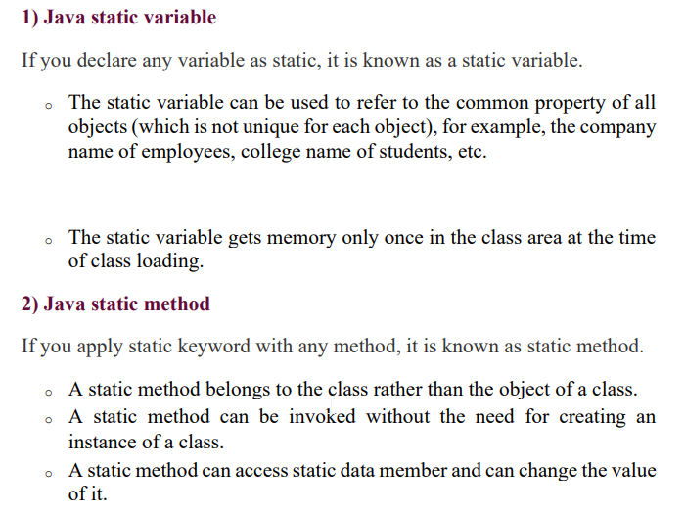

Slide 21
